Slide 1



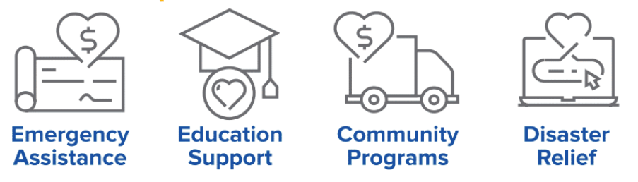

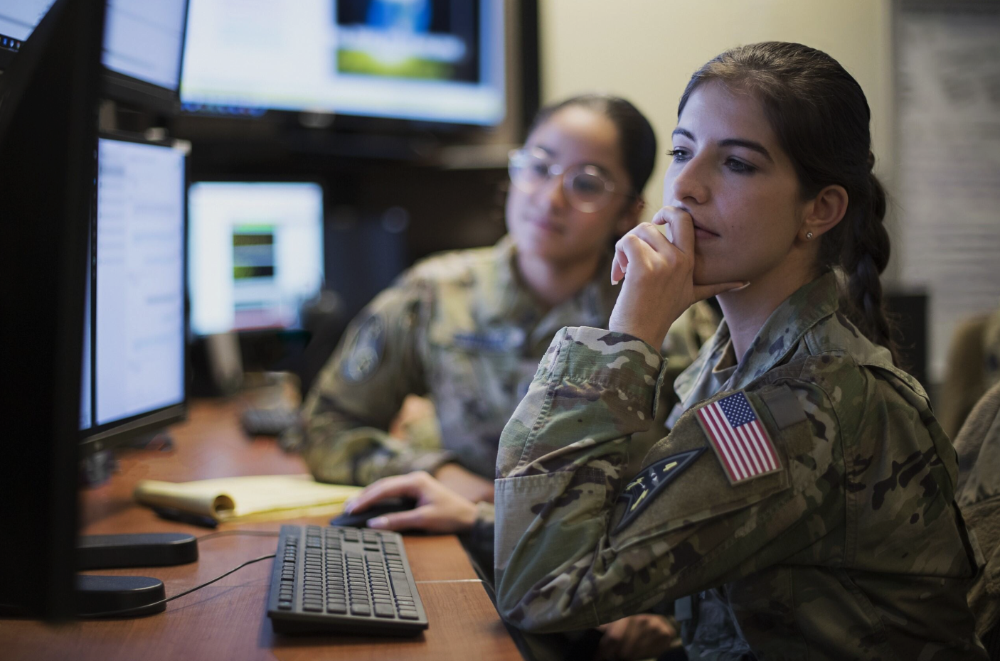



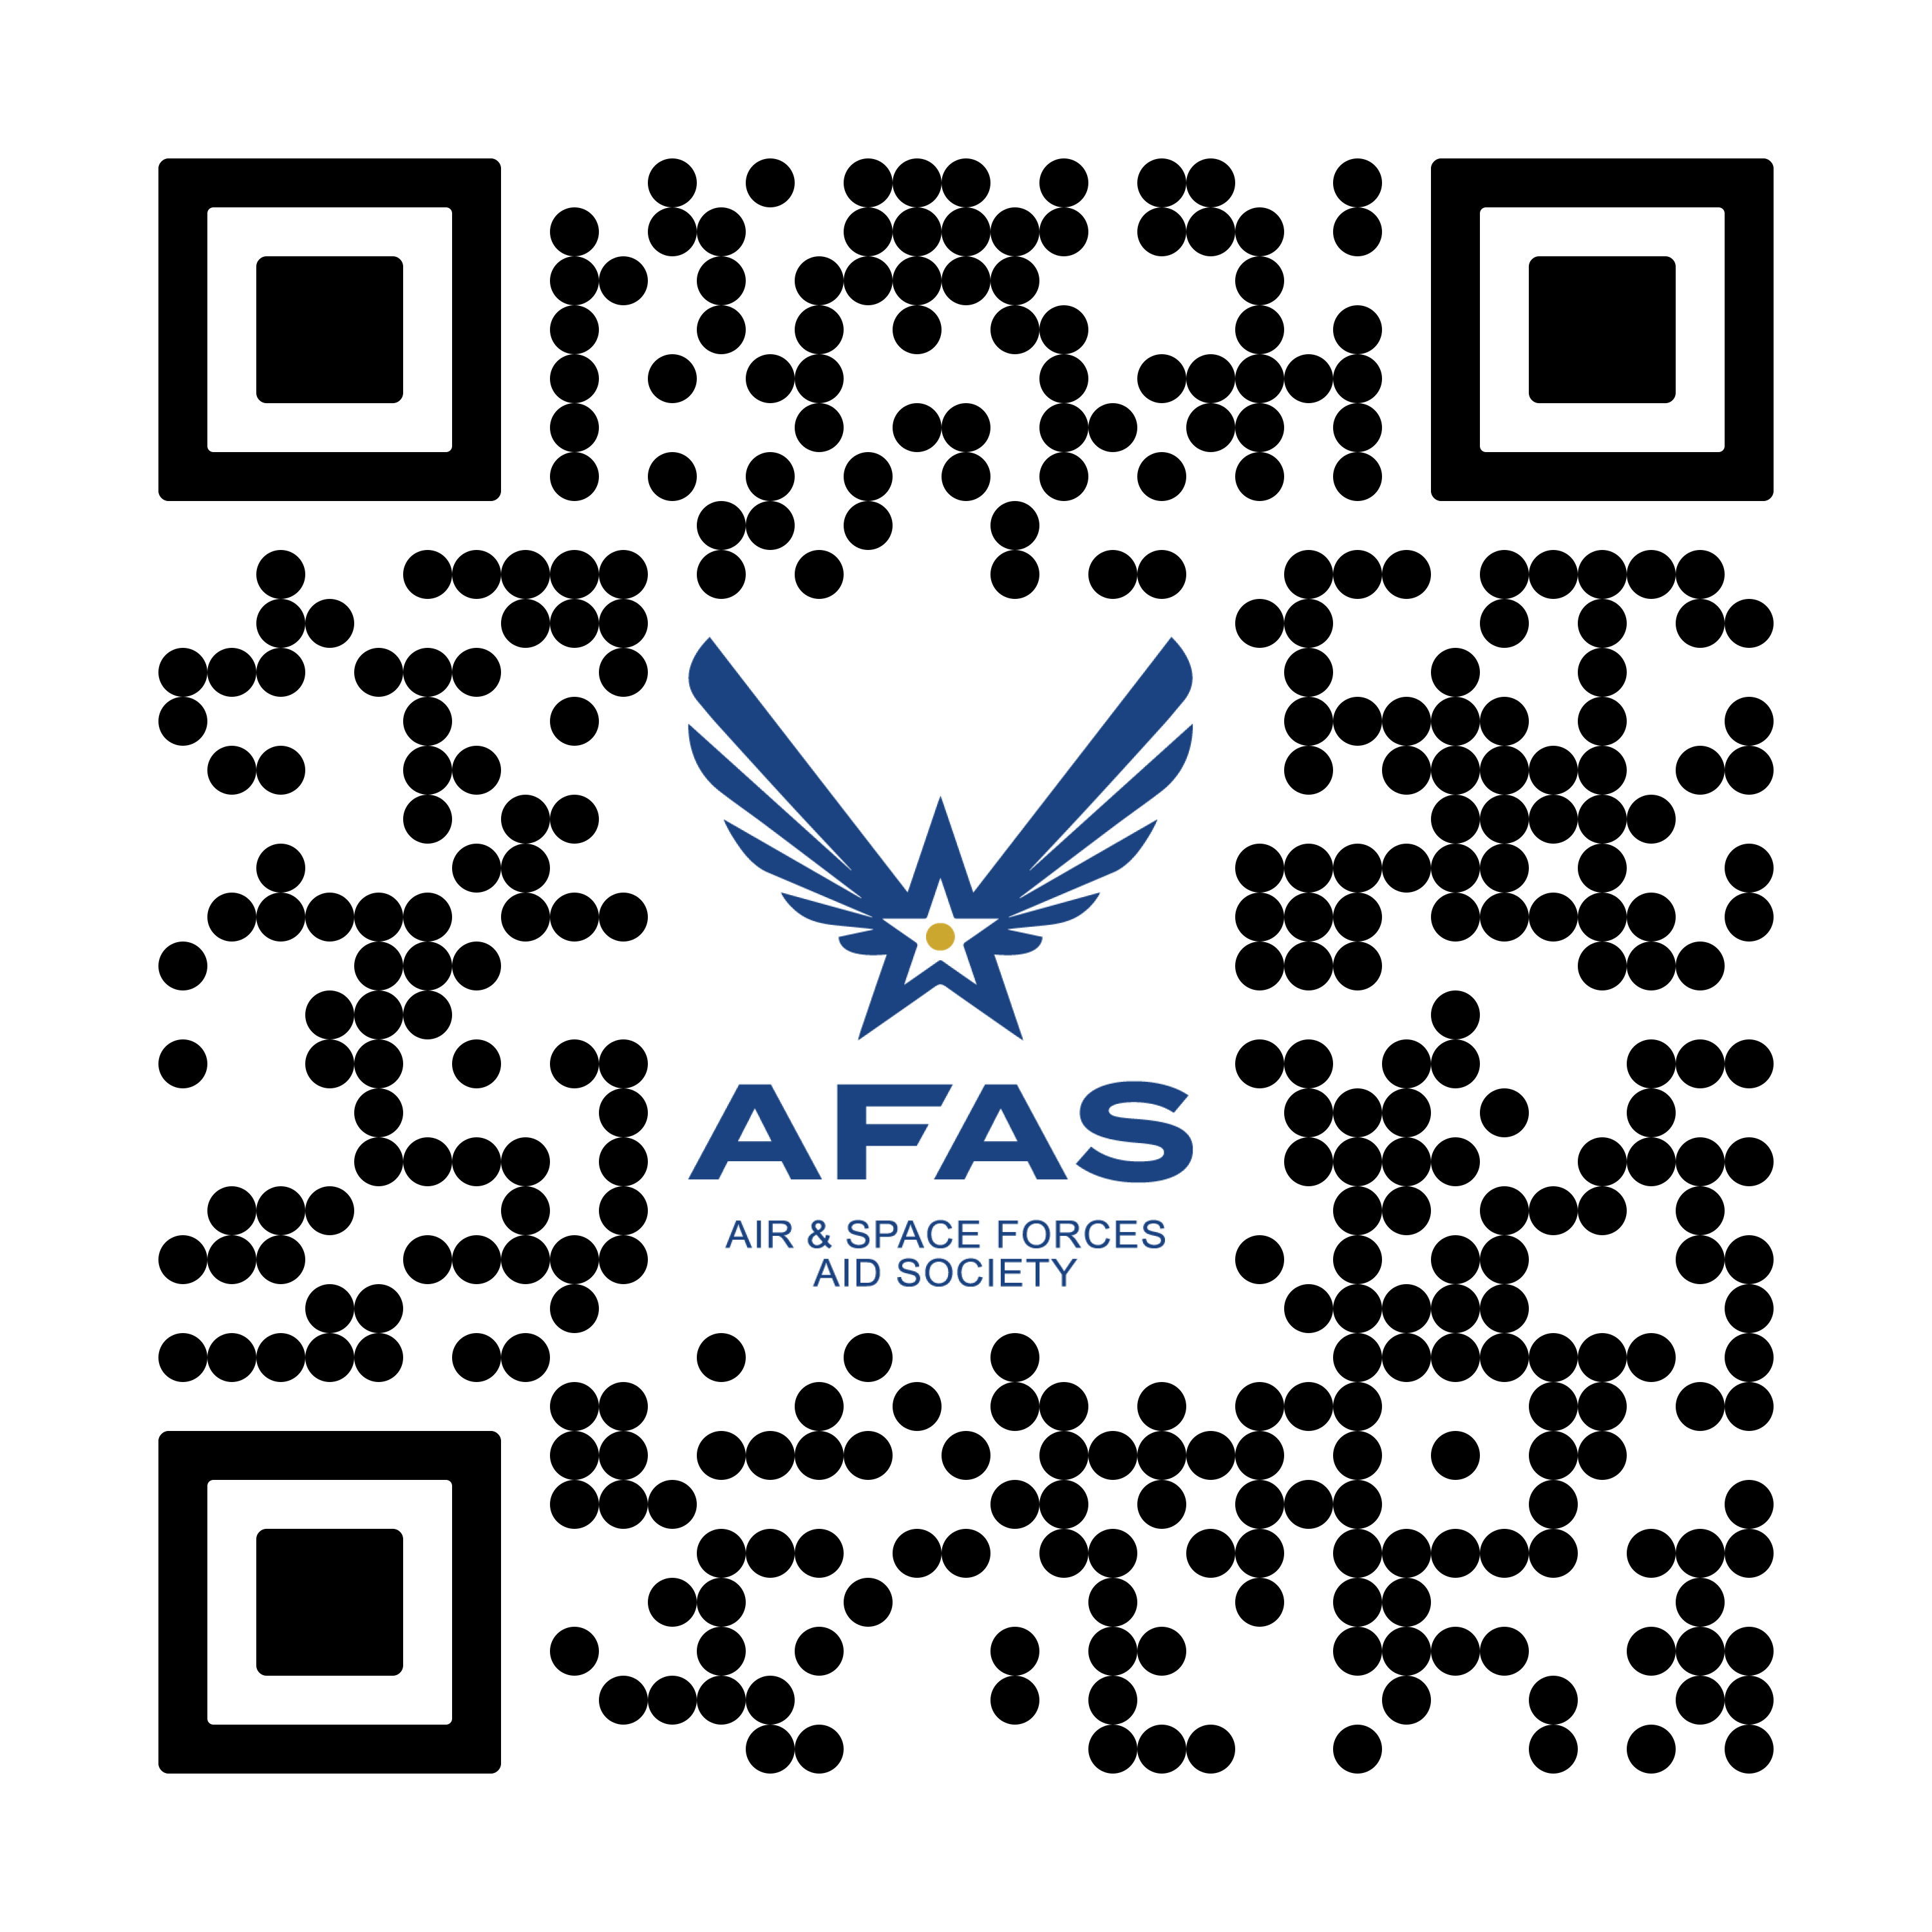





The Official Charity of the
U.S. Air Force and U.S. Space Force
How we help
How to receive support
Our Mission
Basic Living Expenses
Vehicle Repairs
Emergency Travel
Medical & Dental
To help Airmen, Guardians, and their families -
when they need it most!
Visit your local Military & Family Readiness Center
Financial
Assistance
$150 for Baby Essentials
Child Care (for PCS and Families in Need)
(703) 972-2650
Who we serve
College Scholarships (for Spouses & Dependents)
No-Interest Education Loans
$2,500 for Spouse Job Training
Child Care Supplement
afas@afas.org
Active, Guard, Reserve, and Retired Airmen, Guardians and their families
Apply Online
Natural Disasters
Installation Mishaps
Fires
Supporting
the Force
Since 1942
703.972.2650 | afas@afas.org | AFAS.ORG

